Slide 1
Campsite booking
Presented by:
Bhagyalakshmi Bheemaraju
Revuri Varshitha
Maheshkar Soumya
Alamanda Harika
Rayavarapu Leela Prasanna

Slide 2
Contents
Overview
Road Map
Modules
UML Diagrams
Plan
Project Structure

Slide 3
overview
The Aim of this application is to book a CAMPSITE in a small island.
The user will provide his/her email & full name at the time of reserving the campsite.
The user have a unique booking Id identifier back to the caller if the reservation is successful the unique booking identifier can be used to modify or cancel the reservation later on.

Slide 4
roadmap
Implemented tools:
Spring boot Framework+Core java+JPA with Hibernate+PostgreSQL database
RESTful api Service using rest end points+CRUD , Global Exception Handling+JPQL , Customized JPARespository

Slide 5
module
USER
BOOKING
CAMPSITE

Slide 6
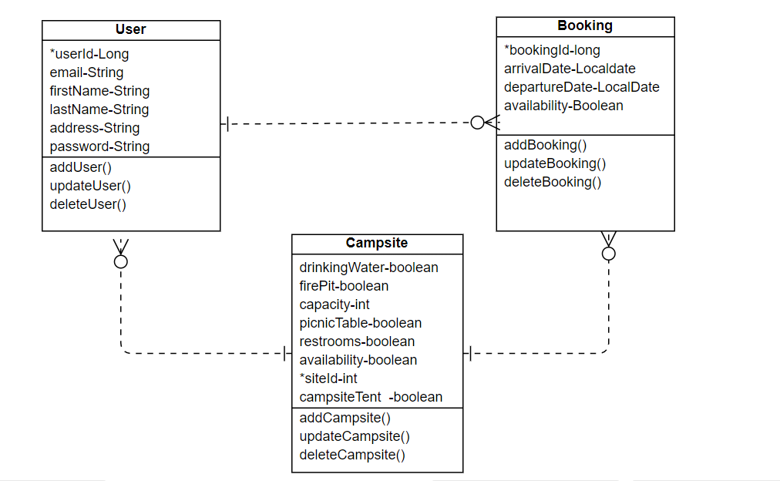
CLASS DIAGRAM

Slide 7
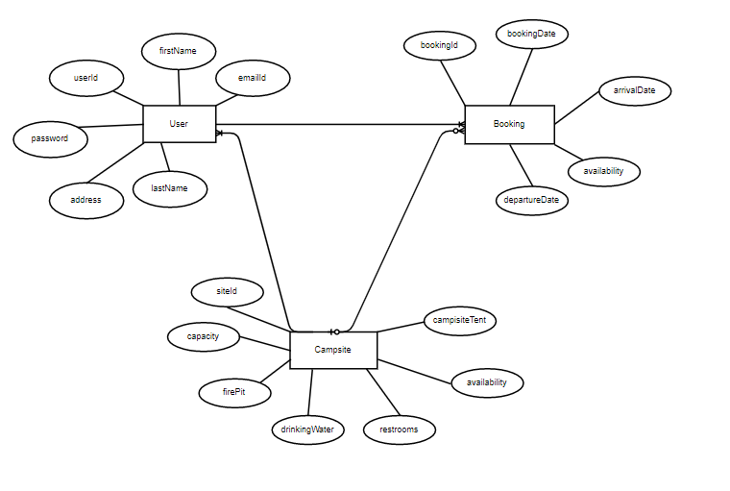
ER DIAGRAM

Slide 8



Software used

Slide 9
plan
1. Design
Generate the skeleton as per Key features provided.
2. TDD approach(Test Driven Development)
Identify test cases for each module
Write Failing Test cases
Convert the Test Cases in GREEN
3. Implement the case study in incremental manner

Slide 10
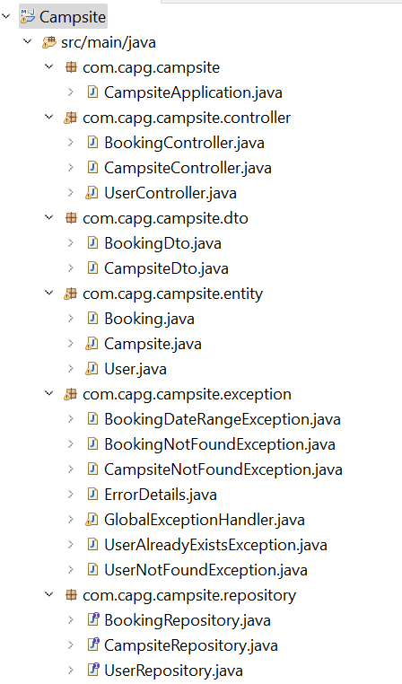
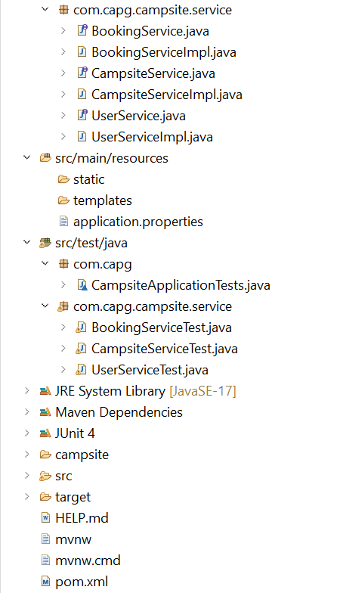
Project structure

Slide 11
Thank you

